Slide 1
Research Question: can alternative approaches based on a combined use of machine learning (ML), socio-economic indicators (SEIs), demographic indicators (DIs), and non-pharmaceutical interventions (NPIs) reliably and accurately predict the cases, deaths, and transmission rates of the SARS-CoV-2 pandemic at a global scale?
Why are the disease trends important? Because projecting cases, deaths, and transmission rates with a robust degree of accuracy weeks in advance can help plan demand for the health care system (e.g. doctors, nurses, ventilators, ICU beds, PPE) by identifying forthcoming peaks or plateaus.
Why is an international scope important? Because understanding the relative effectiveness of variables including NPIs (e.g. government policy), health system preparedness, economic strength, and population structure allows us to understand how the pandemic plays out across the broad spectrums of global diversity to inform and optimize global and local logistic efforts.
The aim of this work is therefore to develop models informed by timeseries data encompassing the empirical diversity of populations and policies across nations; ML approaches driven by SEIs, demographics, and NPIs are tested in conjunction with up-to-date data from the current pandemic.
The objectives that will need to materialize in order to achieve this aim are:
Streamline SARS-CoV-2 data from available reliable sources (e.g. JHU) ◀︎
Collect dynamic data on NPIs for a meaningful number of countries (n=36) with respect to key parameters ◀︎
Collect static data on a broad range of SEIs to capture diversity between countries across key parameters ◀︎|◁
Harmonize 1., 2., and 3. into three leave-one-country-out cross validation decisions tree models for cases, deaths, and transmission rates◀︎
Repeat 4. for all n countries ◁ (Completion Estimate 1: mm/dd/yy)
Evaluate the accuracy and reliability of the model (e.g. errors on number of cases) ◁ (CE2: mm/dd/yy)
Asses the variable importance to identify a) the most effective NPIs and b) the most influential SEIs and DIs ◁ (CE3: mm/dd/yy)
◁ = denotes ongoing activity
◀︎ = denotes completed activity
With objectives 4. 5. and 6. “approved” from an epidemiological/stats perspective, the work is intended to be written up for potential publication in Scientific Reports and possibly uploaded on a preprint repository.

Slide 2
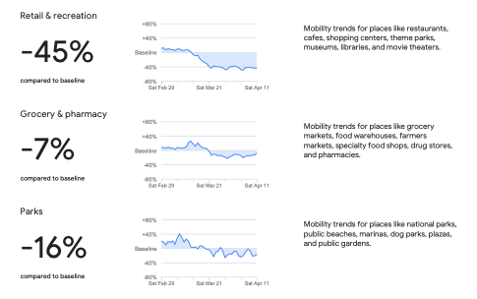
Dynamic Variables
In the model
Soon to be in the model
N cases per 100 million people
R0 N deaths per 100 million people Social_Distancing: 0 = No social distancing measures implemented 1 = Large gatherings banned (e.g. concerts, sporting events, conferences) 2 = Mid-sized gatherings are voluntarily closed (e.g.,, universities, workplaces) 3 = Service industries are closed (e.g., restaurants and pubs) 4 = Shelter-in-place orders for non-essential workers (e.g., NY and California on March 20th) 5 = Lockdown except for shopping Quaranting_Cases: 0 = No action is taken to quarantine cases 1 = Infected individuals are quarantined 2 = Households of infected individuals are quarantined 3 = Others in contact with infected individuals are tracked and then quarantined Close_Border: 0 = No restrictions at the border 1 = Closed to hotspots (e.g. US closing to china) 2 = Closed to multiple highly infected countries 3 = Closed except for essential travel 4 = Closed fully
https://www.google.com/covid19/mobility/
Google Mobility Report for % decrease in mobility for the following areas by date
Grocery_pharmacy
Parks
Residential
Retail_recreation
Transit_stations
Workplaces
With Time Lags

Slide 3
Static Variables
In the model
Soon to be in the model
PopulationStructures: % in each of 0-14 years (children), 15-24 years (early working age), 25-54 years (prime working age), 55-64 years (mature working age), 65 years and over (elderly) KG map linked to latitude/longitude: consider climate/seasonality differences between countries
Population Density: per sq km
CVD prevalence
CHD prevalence
Diabetes prevalence
Asthma prevalence
Allergy prevalence PopulationGrowthRate: population growth rate is an interesting metric PopulationSmoking: % smokers GINI index: a measure of the distribution of income across income percentiles in a population Urbanization: % urban vs rural HouseholdStructure: how many people per household? multigenerational? EFindex: ethnic fractionalization index describing diversity within a country's population Prevent: GHS index for prevention of the emergence or release of pathogens Detect: GHS index for early detection and reporting for epidemics of potential international concern Respond: GHS index for rapid response to and mitigation of the spread of an epidemic Health: GHS index for sufficient and robust health sector to treat the sick and protect health workers Norms: GHS index for commitments to improving national capacity, financing plans to address gaps and adherence to global norms Risk: GHS index for overall risk environment and country vulnerability to biological threats GDP_bill: GDP in billions of USD GDP_percapita: GDP per capita in USD Population_mill: population of a country HumanDevelopmentIndex_2018: development index EIUDemocracyIndexScore_2019: EIU democracy index UNOnlineServicesIndexScore_2018: UN online services index GlobalPeaceIndex: peace index CorruptionsPerceptionIndex_2018: corruption index HumanCapitalIndex_2017: human capital index SDGIndexScore_2018: The Sustainable Development Goals Index Score

Slide 4
Countries
Index | ISO3 | Country
1 | ITA | Italy
2 | GBR | United Kingdom
3 | ZAF | South Africa
4 | BRA | Brazil
5 | ESP | Spain
6 | MYS | Malaysia
7 | CHN/HUB | China/Hubei
8 | KOR | South Korea
9 | USA | United States
10 | SWE | Sweden
11 | AUT | Austria
12 | CHE | Switzerland
13 | DEU | Germany
14 | FRA | France
15 | DZA | Algeria
16 | IRN | Iran
17 | CAN | Canada
18 | TUR | Turkey
19 | BEL | Belgium
20 | ANT | Netherlands
21 | PRT | Portugal
22 | ISR | Israel
23 | RUS | Russia
24 | NOR | Norway
25 | IRL | Ireland
26 | AUS | Australia
27 | IND | India
28 | DNK | Denmark
29 | CHL | Chile
30 | CZE | Czechia
31 | JPN | Japan
32 | UKR | Ukraine
33 | MAR | Morocco
34 | ARG | Argentina
35 | SGP | Singapore
36 | ROU | Romania
Diversity and representation
Differing response (NPIs)
Culturally
Government Structure
Demographics
Socioeconomics
Part of the world
Progression along the curve

Slide 5
Response Variables
N cases per 100 million people
R0 – is there a good database with R0 values by country?
N deaths per 100 million people

Slide 6
Modeling Methodology
Trying many different ML models to evaluate which ones are the best.
Random forests perform well, yet some other ensemble models have lower training error (haven’t expanded to testing error yet).
Results for the random forest model applied to select countries are shown in the following slides
Discussion items on methodology/model selection:
Which models might we want to consider for this?
Some model types have difficulty with the predictions/testing (Chris knows which ones)
What methods should we use to select the best model? Currently using training RMSE
Split of training and test data - see last slide.
Suggesttion from Vanja Dukic is to include ~50% of the test country existing data into the model, since it’s unfair to exclude it.

Slide 7
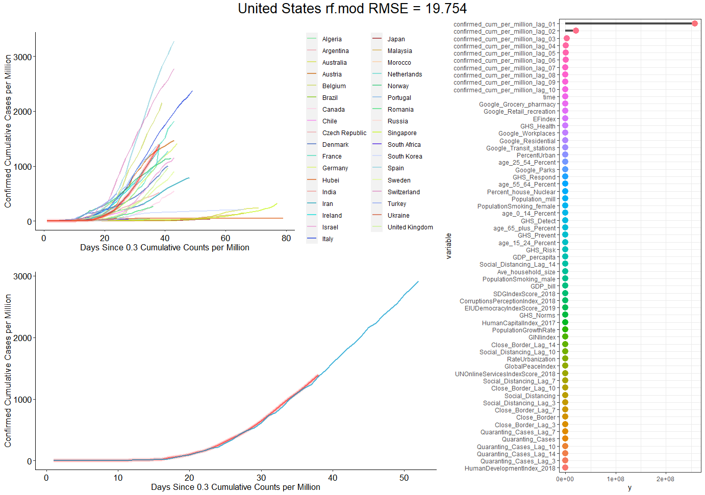
Cases

Slide 8
Deaths

Slide 9
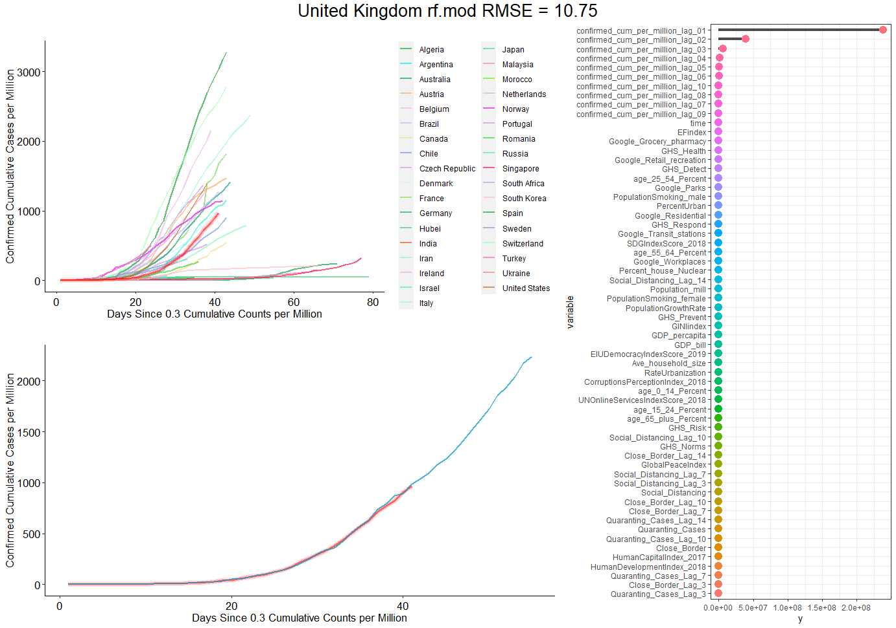
Cases

Slide 10
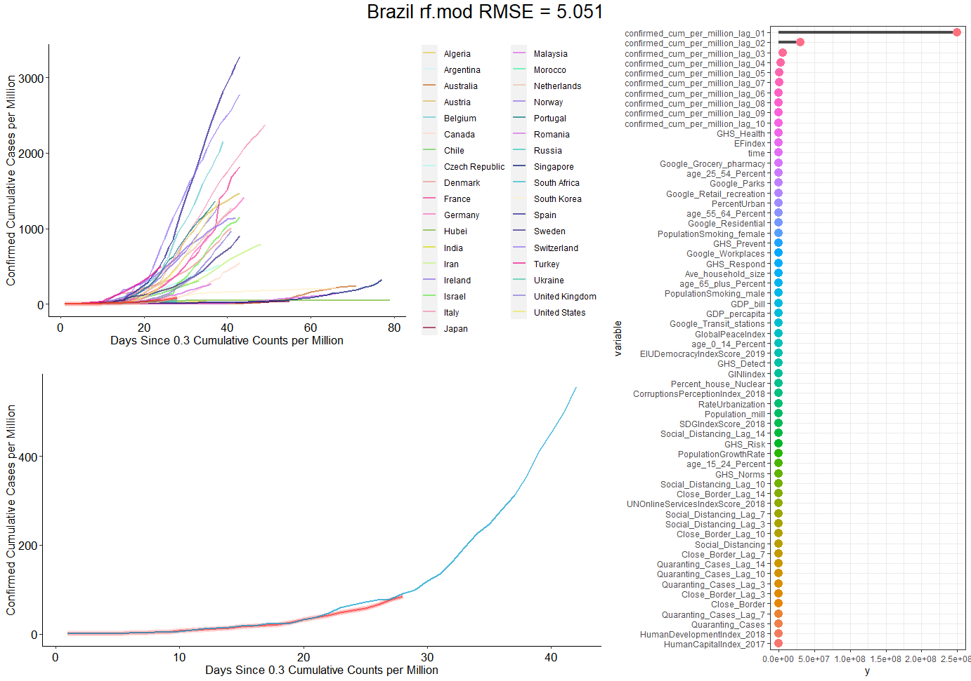
Cases

Slide 11
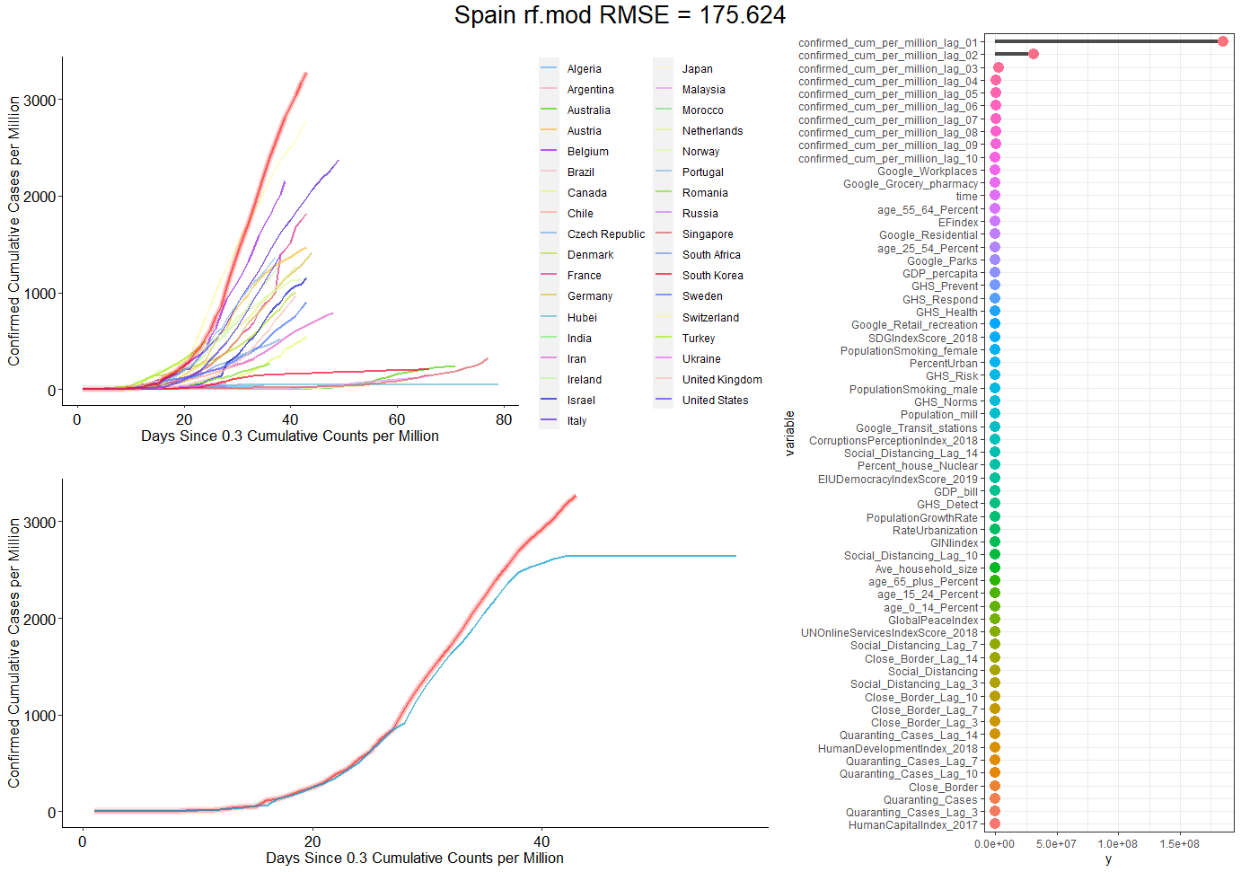
Cases
Would it make sense to remove time?

Slide 12
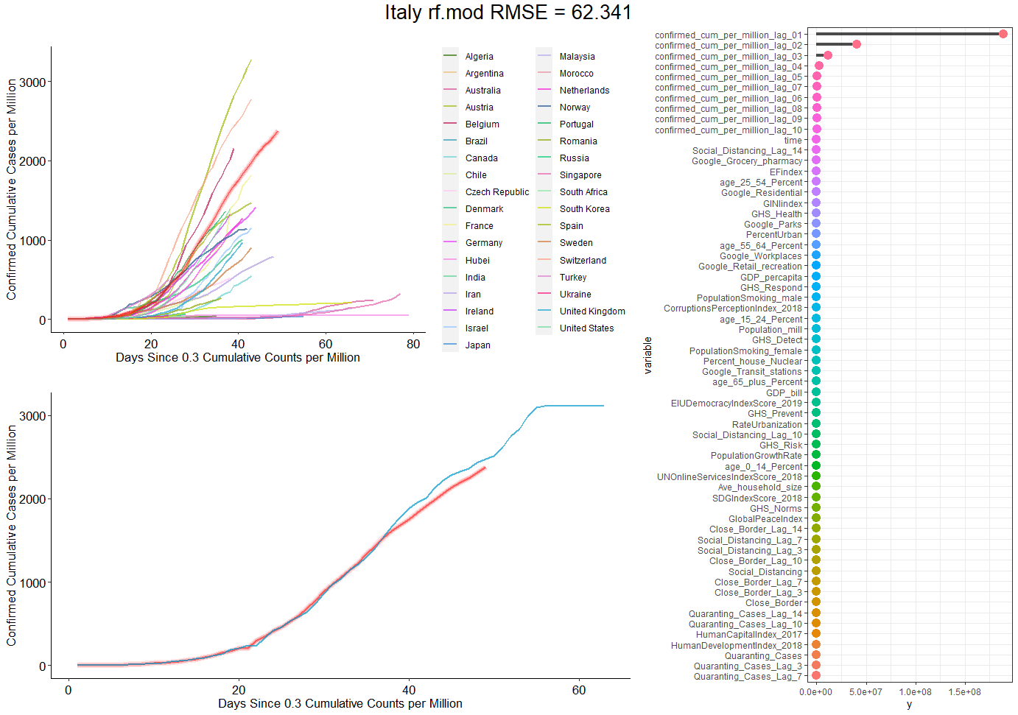
Cases

Slide 13
Model Type – Discussion Topics
Decision Tree
Random forest has been working well – any other model types we should be trying?
Add random forest jackknife confidence intervals for prediction
Explore past variable importance – the cutoff points that push counts in a certain direction
Leave-one-country-out cross validation decisions tree models for cases, deaths, and transmission rates
Is this an okay method? Are we overfitting in any way?
How should we be dealing with NA datapoints?
How many lag factors… 10?
Length of forecasting?
It would be awesome if we could expand this to all 50 US states as well…
Writeup/Publication timeline?

